Slide 1
Course : COMP8043 – Machine Learning
Period : September 2020
Support Vector Machine (SVM)
Session 07
KDS – Amalia Zahra, S.Kom., Ph.D.

Slide 2
Learning Outcomes
After the completion of this session, students are expected to achieve the following learning outcomes:
LO2: Describe the characteristics of various Machine Learning algorithms and understand how each of them works, including the mathematical principles underlying the algorithms.
LO3: Apply relevant Machine Learning algorithms according to individual cases/problems and perform evaluation.
LO4: Analyze the results obtained from Machine Learning experiments from several perspectives.

Slide 3
Session Outcomes
By completing this session, you will be able to:
Describe the concept of SVM
Describe the implementation of SVM to solve linearly and non-linearly separable classes
Describe the types and the functionality of kernels
Summarize steps in SVM

Slide 4
Topics
Fundamental Concepts of SVM
Two-Class SVM
Multi-Class SVM
Kernels

Slide 5
FUNDAMENTAL CONCEPTS OF SVM

Slide 6
SVM—History and Applications
Vapnik and colleagues (1992) — groundwork from Vapnik & Chervonenkis’ statistical learning theory in 1960s.
Features: training can be slow, but accuracy is high owing to their ability to model complex nonlinear decision boundaries (margin maximization).
Used for: classification and numeric prediction.
Applications:
  handwritten digit recognition, object recognition, speaker identification, benchmarking time-series prediction tests.

Slide 7
Support Vector Machines (SVM)
A relatively new classification method for both linear and nonlinear data.
It uses a nonlinear mapping to transform the original training data into a higher dimension.
In the new dimension, it searches for the linear optimal separating hyperplane (i.e., “decision boundary”).
With an appropriate nonlinear mapping to a sufficiently high dimension, data from two classes can always be separated by a hyperplane.
SVM finds this hyperplane using support vectors (“essential” training tuples) and margins (defined by the support vectors).

Slide 8
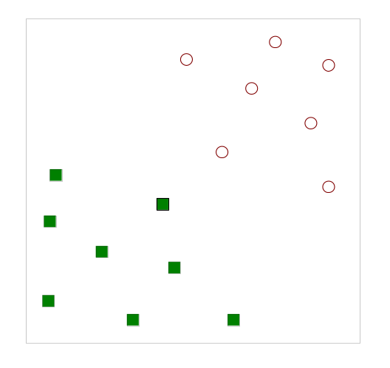
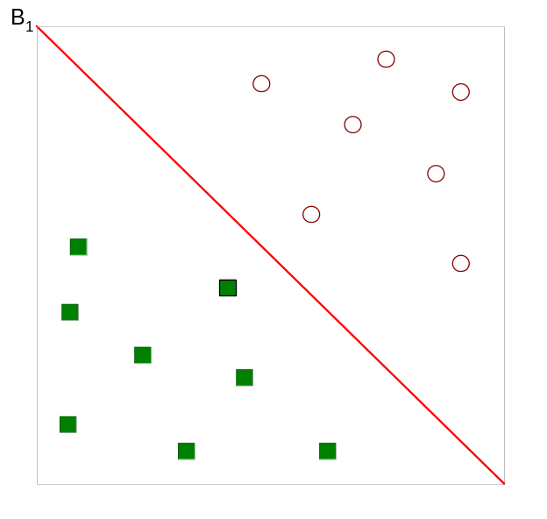
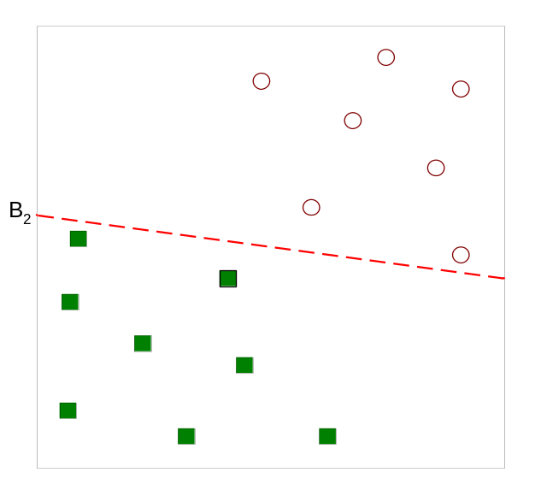
Support Vector Machines
SVM goal: Find a linear equation (hyperplane) that will separate the data, but which one?

Slide 9
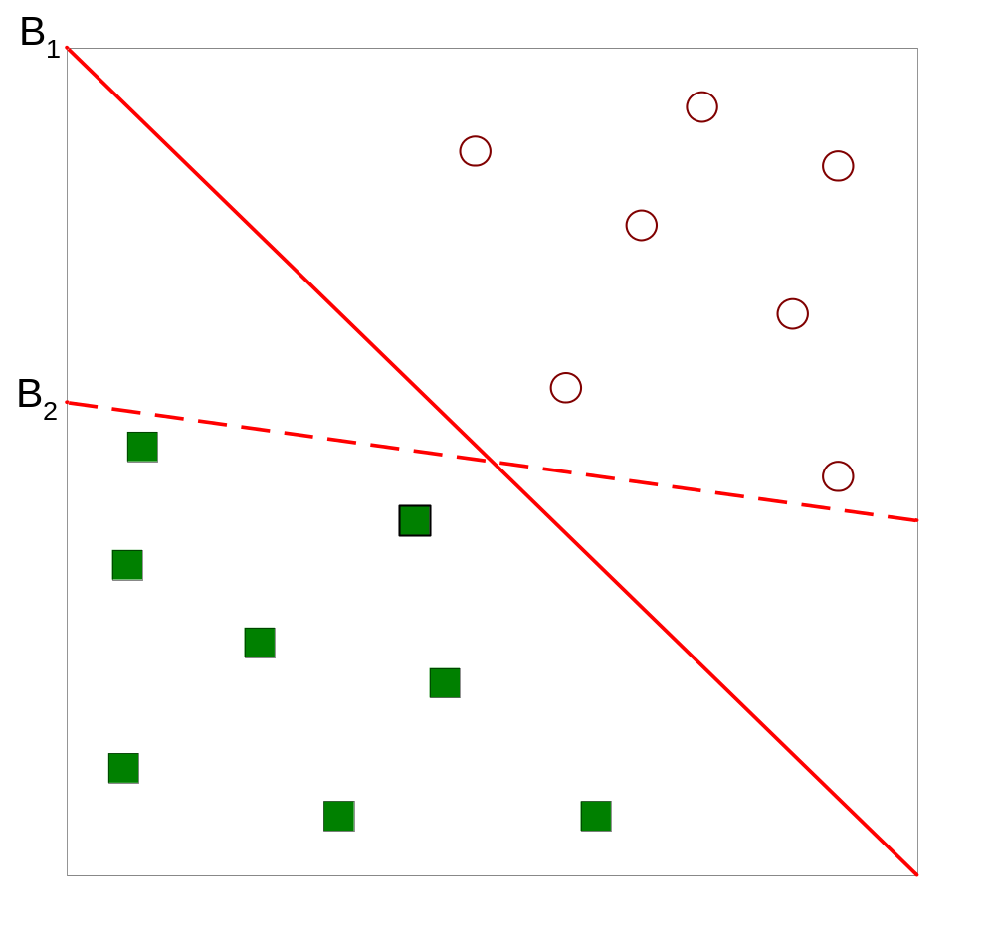
Support Vector Machines
Which one is better? B1 or B2?
How do you define better?

Slide 10
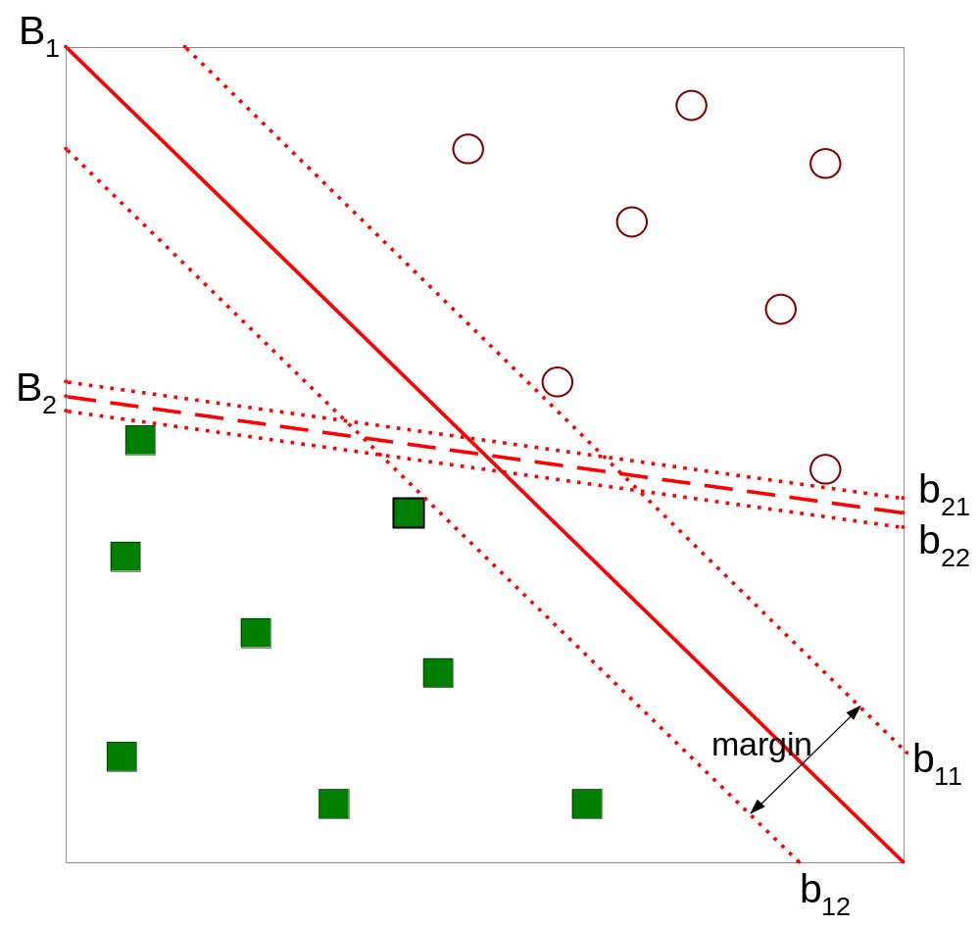
Support Vector Machines
Find hyperplane that maximizes the margin => B1 is better than B2

Slide 11
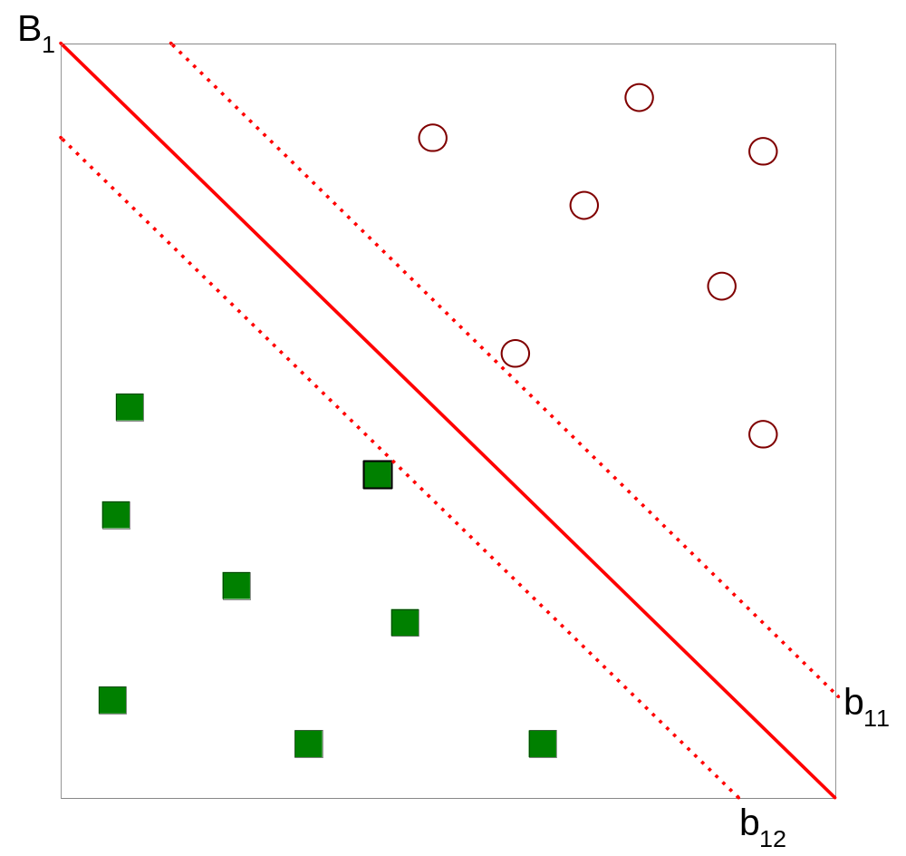



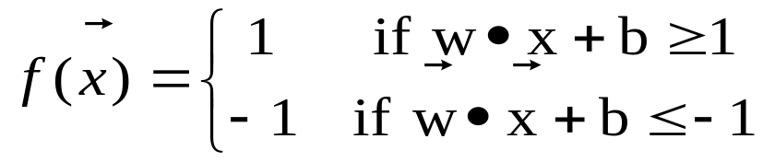
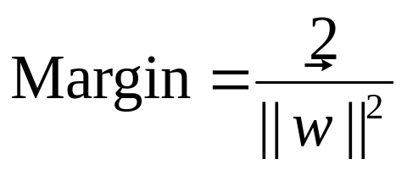
Support Vector Machines

Slide 12
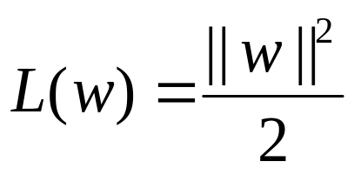
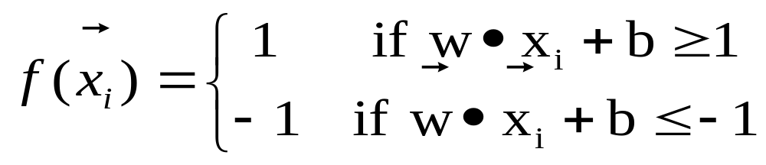
Support Vector Machines
We want to maximize:
  Which is equivalent to minimizing:
  But subjected to the following constraints:
    This is a constrained optimization problem
      Numerical approaches to solve it (e.g., quadratic programming)

Slide 13
General Philosophy
Small Margin
Large Margin
Support Vectors

Slide 14
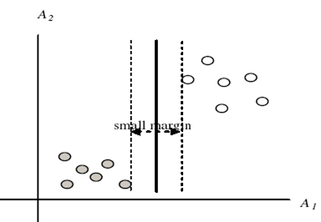

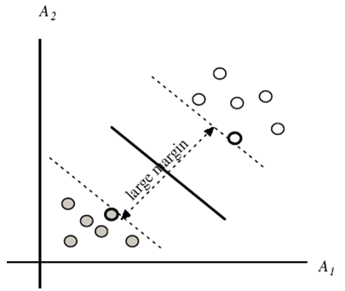
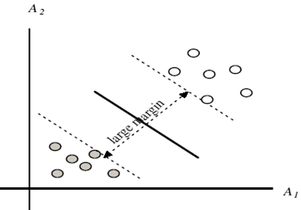
Margins and Support Vectors

Slide 15
TWO-CLASS SVM

Slide 16
When Data is Linearly Separable
m
Let data D be (X₁, y₁), …, (X_{|D|}, y_{|D|}), where X_{i} is the set of training tuples associated with the class labels y_{i}
There are infinite lines (hyperplanes) separating the two classes, but we want to find the best one (the one that minimizes classification error on unseen data)
SVM searches for the hyperplane with the largest margin, i.e., maximum marginal hyperplane (MMH)

Slide 17
Linearly Separable
A separating hyperplane can be written as
    W ● X + b = 0
  where W={w₁, w₂, …, w_{n}} is a weight vector and b a scalar (bias).
For 2-D it can be written as:
    w₀ + w₁ x₁ + w₂ x₂ = 0
The hyperplane defining the sides of the margin:
    H₁: w₀ + w₁ x₁ + w₂ x₂ ≥ 1 for y_{i} = +1, and
    H₂: w₀ + w₁ x₁ + w₂ x₂ ≤ – 1 for y_{i} = –1
Any training tuples that fall on hyperplanes H₁ or H₂ (i.e., the
sides defining the margin) are support vectors
This becomes a constrained (convex) quadratic optimization problem: Quadratic objective function and linear constraints → Quadratic Programming (QP) → Lagrangian multipliers

Slide 18
Why is SVM Effective on High Dimensional Data?
The complexity of trained classifier is characterized by the # of support vectors rather than the dimensionality of the data.
The support vectors are the essential or critical training examples — They lie closest to the decision boundary (MMH).
If all other training examples are removed and the training is repeated, the same separating hyperplane would be found.
The number of support vectors found can be used to compute an (upper) bound on the expected error rate of the SVM classifier, which is independent of the data dimensionality.
Thus, an SVM with a small number of support vectors can have good generalization, even when the dimensionality of the data is high.
Notes:
Demo in RapidMiner

Slide 19
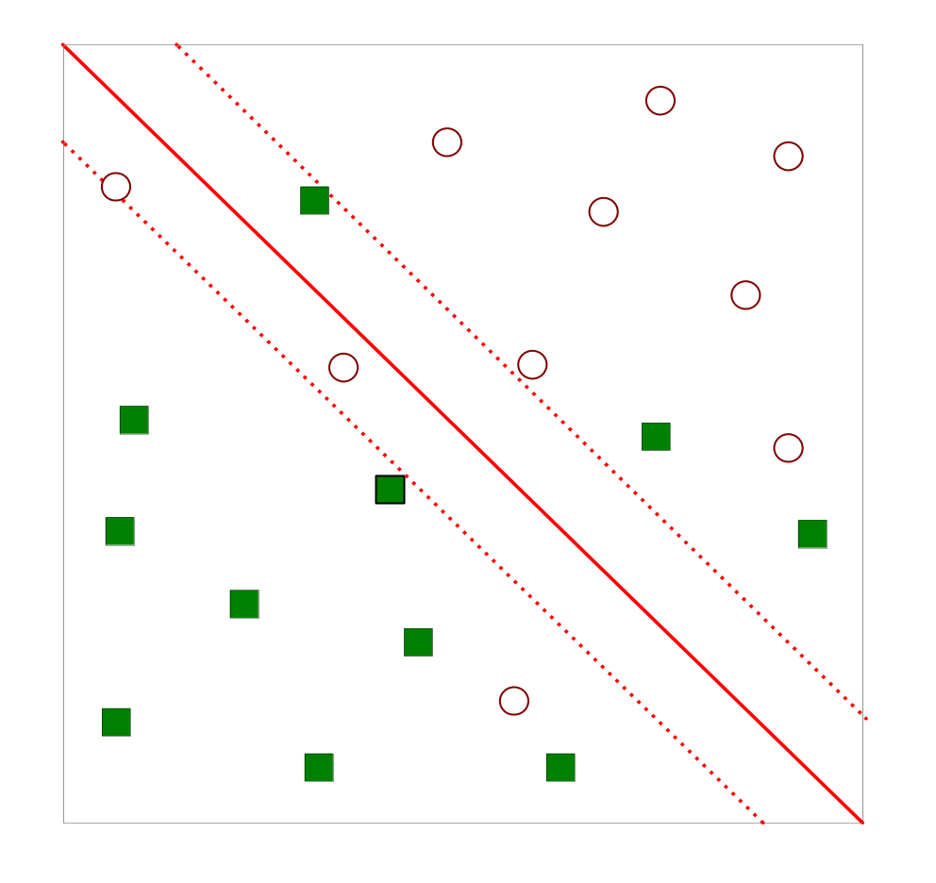
Overlapping Distribution
What if the problem is not linearly separable?

Slide 20
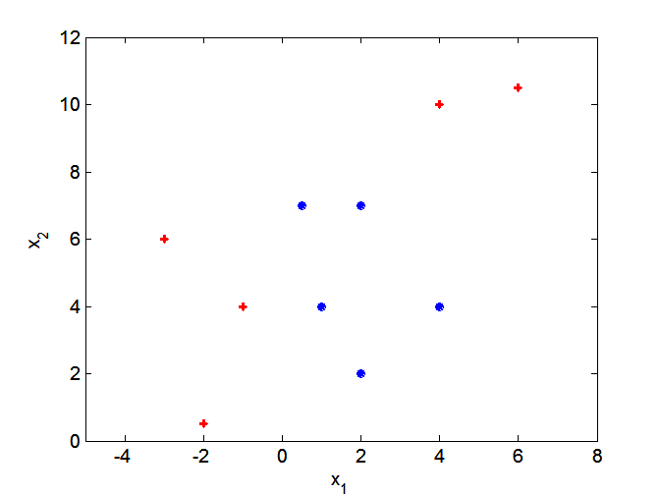
Nonlinear Boundary
What if decision boundary is not linear?

Slide 21
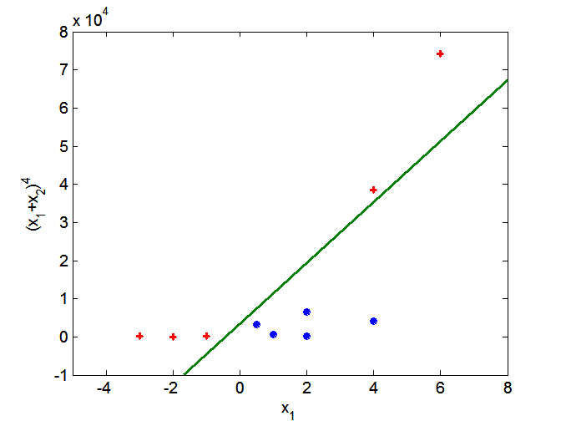
Data Transformation
Transform the data into higher dimensional space

Slide 22
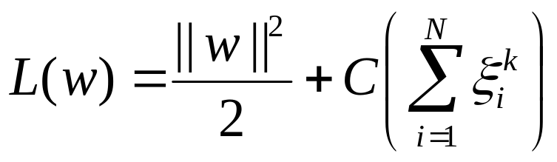
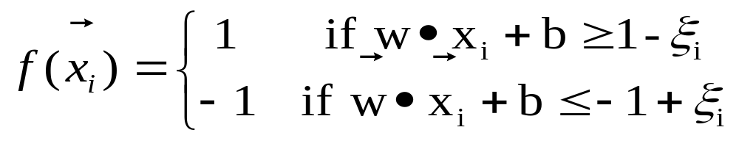
Nonlinear SVM
What if the problem is not linearly separable?
  Transform the original input data into a higher dimensional space.
  Introduce slack variables
    Need to minimize:
    Subject to:
Notes:
Slack variables are introduced to allow certain constraints to be violated. That is, certain training points will be allowed to be within the margin. We want the number of points within the margin to be as small as possible, and of course we want their penetration of the margin to be as small as possible.

Slide 23
MULTI-CLASS SVM

Slide 24
Multi-Class Classification in SVM
There are 3 approaches used for multi-class classification in SMV:
  one-vs-all or one-vs-rest
  all pairs
  error correcting output codes (ECOC)

Slide 25
Approach 1: One-vs-All
Transform a k-class problem into k binary classifications, and then solve separately.
  E.g. a 3-class classification task is transformed into 3 binary classifications:
    class-1 vs non-class-1
    class-2 vs non-class-2
    class-3 vs non-class-3
Combine predictions: evaluate all predictions, hope exactly one is positive (otherwise, take highest confidence).

Slide 26
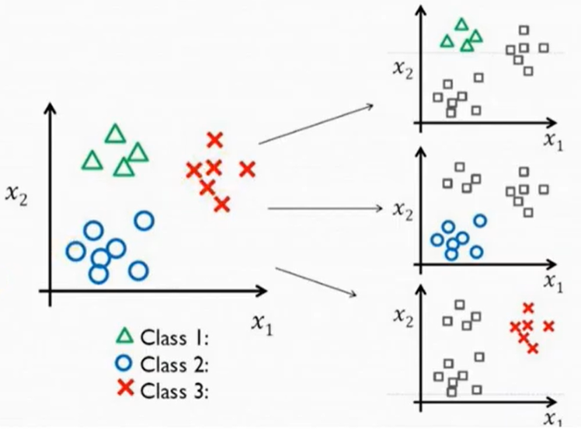
One-vs-All: Illustration

Slide 27
Approach 2: All Pairs
One binary problem for each pair of classes.
  a.k.a one-vs-one
Prediction based on vote: Take class with most positives and least negatives.
Faster and more accurate than one-vs-all.

Slide 28
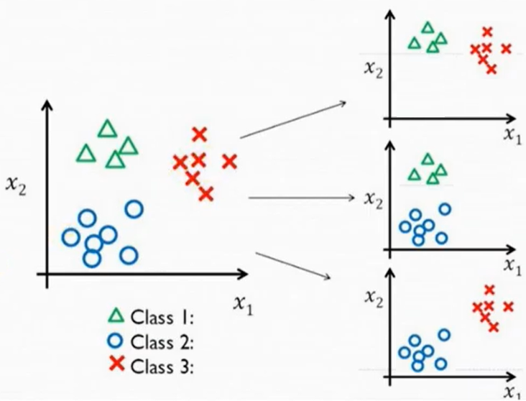
All Pairs: Illustration

Slide 29
Approach 3: Error Correcting Output Codes (ECOC)
“Error-Correcting Output Codes (ECOC) is a simple yet powerful approach to deal with a multi-class problem based on the combination of binary classifiers.”
(Zhou, Z. H. (2012). Ensemble methods: foundations and algorithms. CRC press.)

Slide 30
Approach 3: Error Correcting Output Codes (ECOC) – cont.
Reframe a multi-class classification problem as multiple binary classification problems.
Create a binary encoding (e.g. a bitstring) to represent each class in the problem.
Each bit in the string can be predicted by a separate binary classification problem.
Commonly, the length of the bitstring has more bits than needed in order to uniquely represent each class. The bitstring randomly generated works as well as the optimally constructed one.
A prediction is conducted using all the binary classifiers defined earlier, resulting in an output bitstring. Compare this bitstring to that from each class. The class’s bitstring that has the smallest distance to the prediction is then chosen as the output.
Ref: Dietterich, T. G., & Bakiri, G. (1991, July). Error-correcting output codes: A general method for improving multiclass inductive learning programs. In AAAI (pp. 572-577).

Slide 31
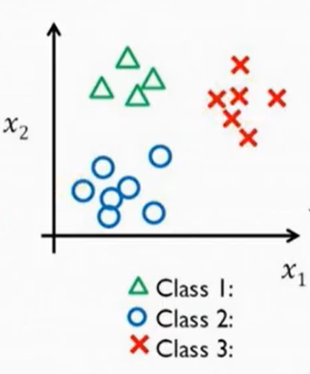


ECOC: Illustration
Binary Encoding for each class:
code length = 2 x k
s₁
s₂
class | b₁ | b₂ | b₃ | b₄ | b₅ | b₆
 | 1 | 0 | 1 | 0 | 1 | 0
 | 0 | 0 | 1 | 1 | 0 | 0
 | 1 | 1 | 0 | 1 | 1 | 0
sufficiently far apart
s₄
s₃
randomly generated
sample | b₁ | b₂ | b₃ | b₄ | b₅ | b₆
s₁ | 1 | 0 | 1 | 0 | 1 | 0
s₂ | 0 | 0 | 1 | 1 | 0 | 0
s₃ | 1 | 1 | 0 | 1 | 1 | 0
s₄ | 0 | 0 | 1 | 1 | 0 | 0
… so on
SVM classifier is built for each bit

Slide 32
KERNELS

Slide 33
Brief Review
The main ideas behind SVM are:
  Start with data in a relatively low dimension.
  Move the data into a higher dimension.
  Find a Support Vector Classifier that separates the higher dimensional data into two groups.
How do we decide how to transform the data?
  Use Kernel Functions!
  To systematically find Support Vector Classifiers in higher dimensions.

Slide 34
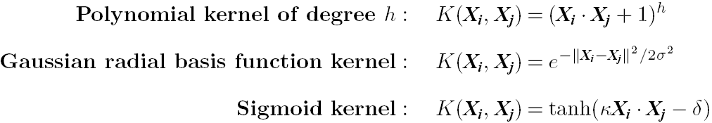
Kernel Functions for Nonlinear Classification
Instead of computing the dot product on the transformed data, it is mathematical equivalent to applying a kernel function K(X_{i}, X_{j}) to the original data i.e. K(X_{i}, X_{j}) = Φ(X_{i}) Φ(X_{j}).
Typical Kernel Functions
SVM can also be used for classifying multiple (> 2) classes and for regression analysis (with additional parameters).
Notes:
Demo in RapidMiner

Slide 35
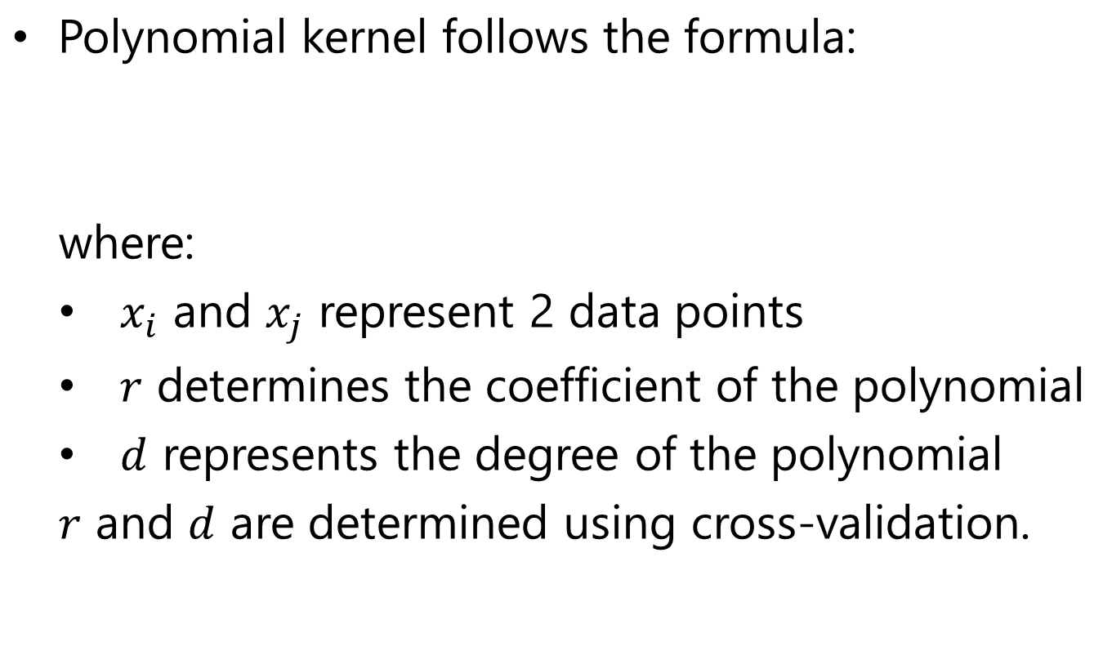
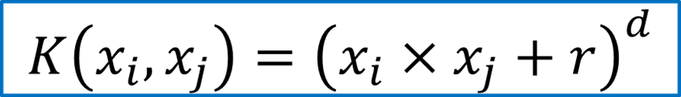
Polynomial Kernel

Slide 36
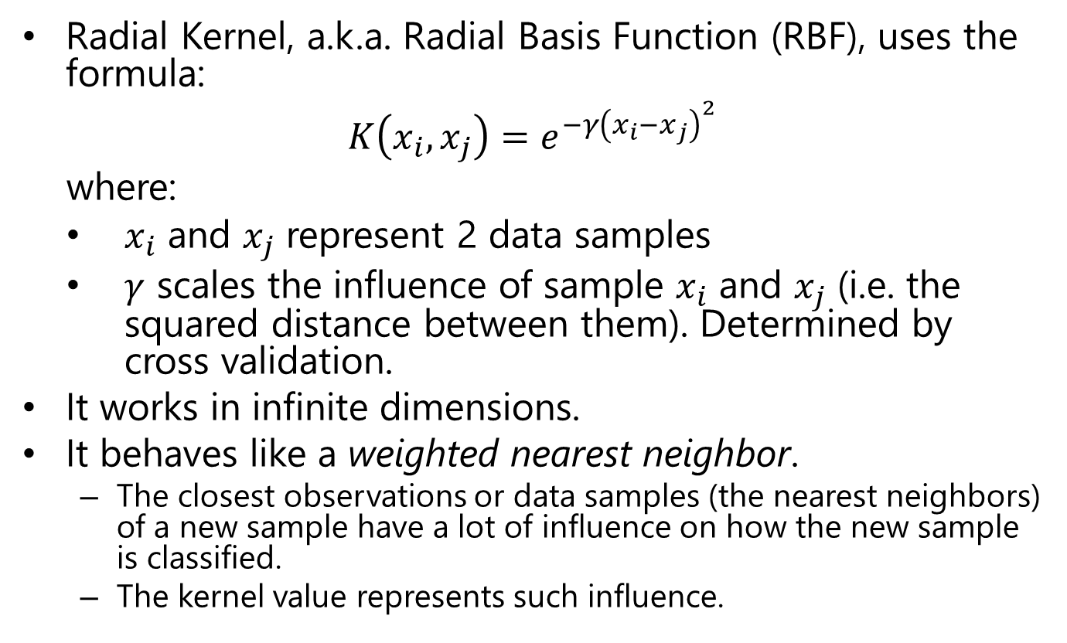
RBF Kernel
Notes:
Additional knowledge on RBF Kernel: https://www.youtube.com/watch?v=Qc5IyLW_hns

Slide 37
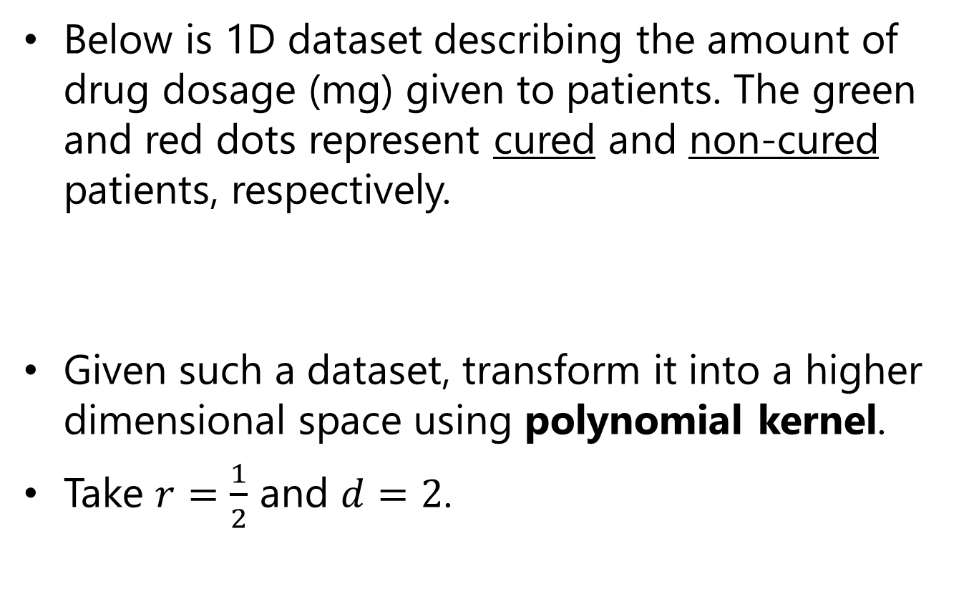

Example: Polynomial Kernel

Slide 38
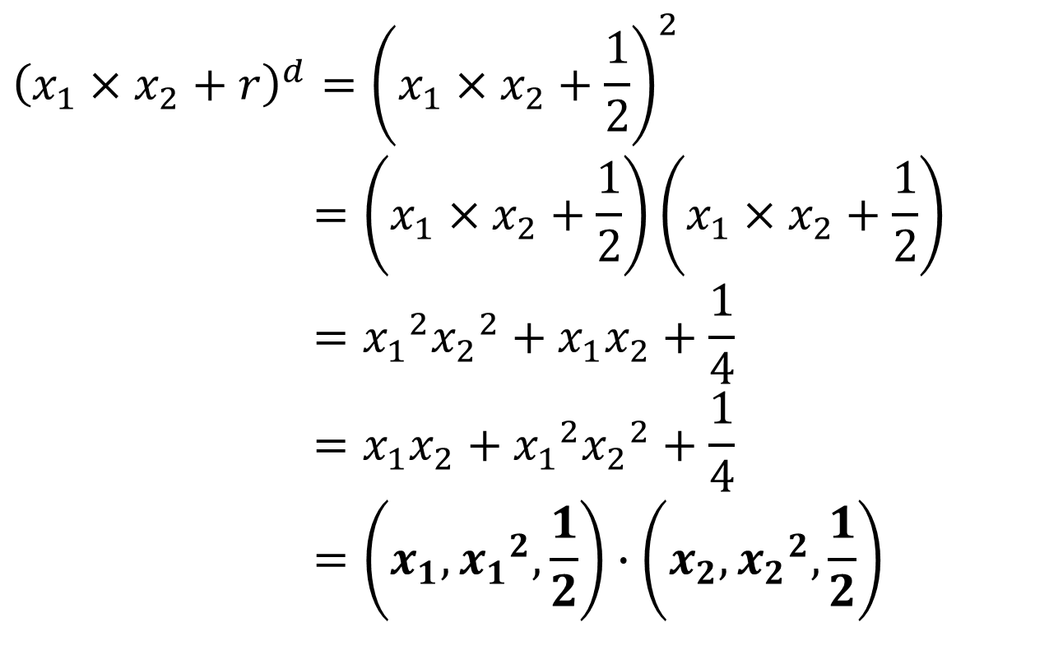
Example: Polynomial Kernel (Solution)
Dot Product

Slide 39
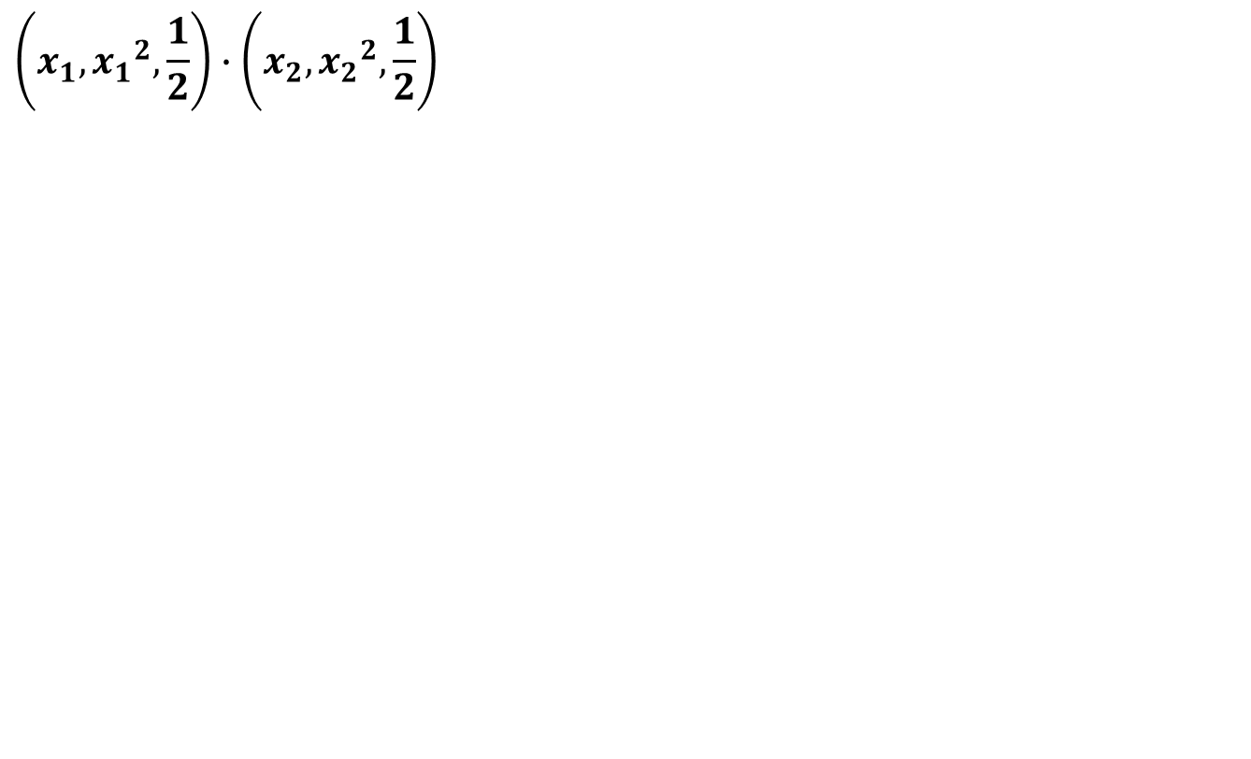

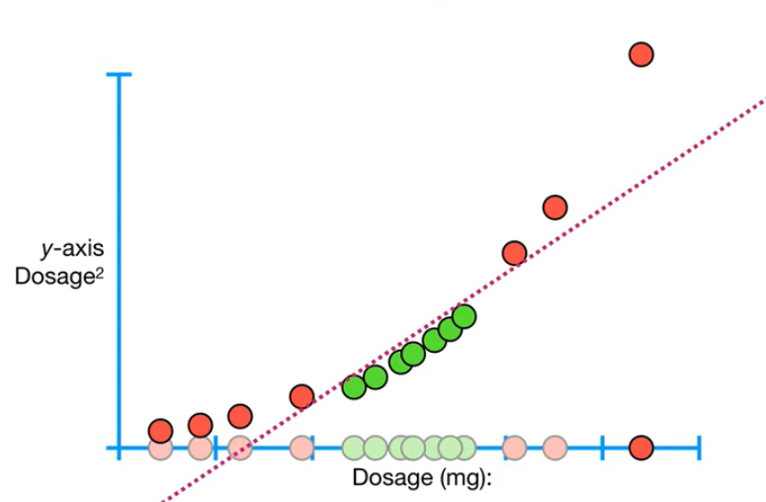
Example: Polynomial Kernel (Solution)
Now, we can find a line to separate the two classes of patients.

Slide 40
SVM Related Links
SVM Website: http://www.kernel-machines.org/
Representative implementations
  LIBSVM: an efficient implementation of SVM, multi-class classifications, nu-SVM, one-class SVM, including also various interfaces with java, python, etc.
  SVM-light: simpler but performance is not better than LIBSVM, support only binary classification and only in C.
  SVM-torch: another recent implementation also written in C.

Slide 41
SVM vs. Neural Network
SVM
  Deterministic algorithm
  Nice generalization properties
  Hard to learn – learned in batch mode using quadratic programming techniques
  Using kernels can learn very complex functions
Neural Network
  Nondeterministic algorithm
  Generalizes well but doesn’t have strong mathematical foundation
  Can easily be learned in incremental fashion
  To learn complex functions—use multilayer perceptron (nontrivial)

Slide 42
References
Rokach, L. (2010). Pattern classification using ensemble methods (Vol. 75). World Scientific.
Hastie, T., Tibshirani, R., & Friedman, J. (2009). The elements of statistical learning: data mining, inference, and prediction. Springer Science & Business Media.
Bishop, C. M. (2006). Pattern recognition and machine learning. springer.
Mitchell, Tom M. (1997). Machine learning. McGraw Hill.

Slide 43
Q&A

Slide 44


